Slide 1
Draupadi asks her husband, Yudhishthira, about unmerited suffering: "When everything was going so well for us, why was our kingdom stolen in a rigged game of dice?" she complains. She exhorts her husband, who gambled away the kingdom, to raise an army and get their possessions back. But he reminds her that he has given his word to his enemies to remain in exile for 13 years as punishment for losing the game.
"What is the point of being good?" she persists. "Isn't it better to be powerful and rich than to be good in an unfair world where those who steal and cheat sleep on sheets of silk and pillows of down while those who are good have to settle for the hard earth? Why be good?" To this he replies in the only way that he knows: "I act because I must."
I act because I must

Slide 2
Ethics
Greek word Ethike: Social environment, ethos or Social milieu.
It refers to everything that is part and parcel of society.
Ethics is a branch of philosophy known as 'moral philosophy'. Moral philosophy is about life and how it should be lived. And so ethics is about the philosophy of life and how it governs our dealings with our fellow human beings and the world we live in.
The field of ethics (or moral philosophy) involves systematizing, defending, and recommending concepts of right and wrong behaviour.

Slide 3
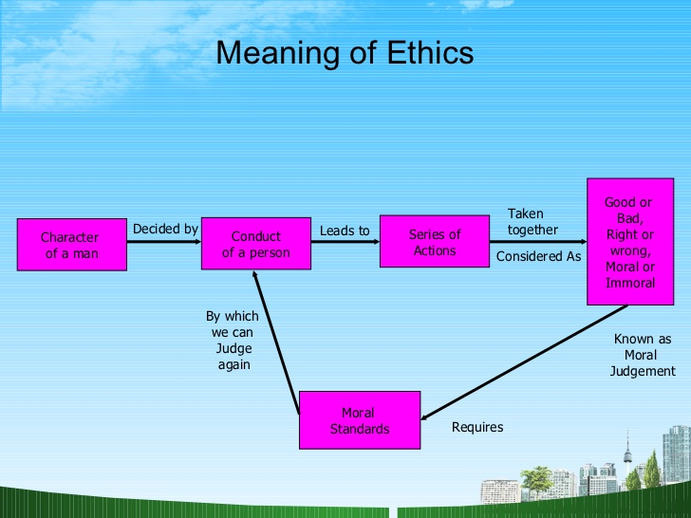

Slide 4
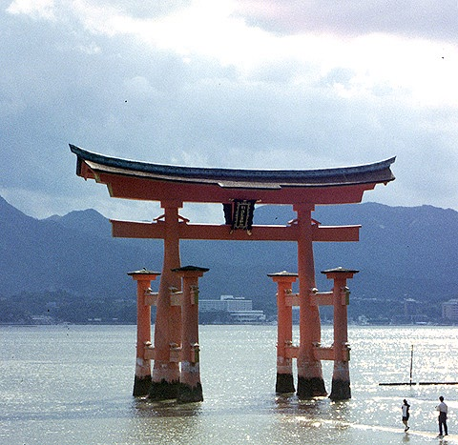
The reputation of a thousand years may be determined by the conduct of one hour.
Japanese proverb

Slide 5
Evolution of Ethics
Social conduct evolved along with the evolution of society.
Code of conduct passed down from generation to generation.
Acceptable behavior is promoted & elevated as a social value, unaccepted behavior is rejected and condemned.
Laws of country based on customs or moral codes of its society.
Object of social codes of conduct is to maintain, promote and elevate harmonious relationship.

Slide 6
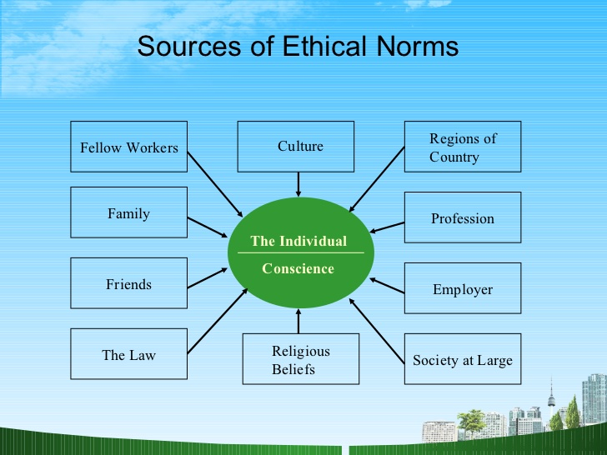
Geography & Topology

Slide 7
Every society makes some determination of morally correct behavior.
In Islamic countries, a determination of what is right or moral is tied to religious scriptures.
In societies more secular, the influence of religious beliefs may be less obvious, but still a key factor.
In the United States much of what is believed to be right or wrong is based in Judeo-Christian heritage. The Ten Commandments, for many people, define what is morally right or wrong.
Societies not only regulate the behavior of their members, but also define their societal core values. "Life, liberty, and the pursuit of happiness" represent core American values.

Slide 8
Society define Values and Ethics
US Culture | Indian Culture | Japanese Culture
Individuals can influence future | Life is a pre planned, Human action is pre determined. | Groupism
I can change work to achieve objective commitment to organization | I need to adjust, human action is pre determined. | Homogeneity
Data based decisions and they are healthy | Decisions flow from the experience and Wisdom of authorities. | Confucian Ethics.
I can disagree. | Deference to age and seniority, suppression of negative feelings. | High educational levels
Protestant Ethic | Joint family and authoritarian values | Group

Slide 9
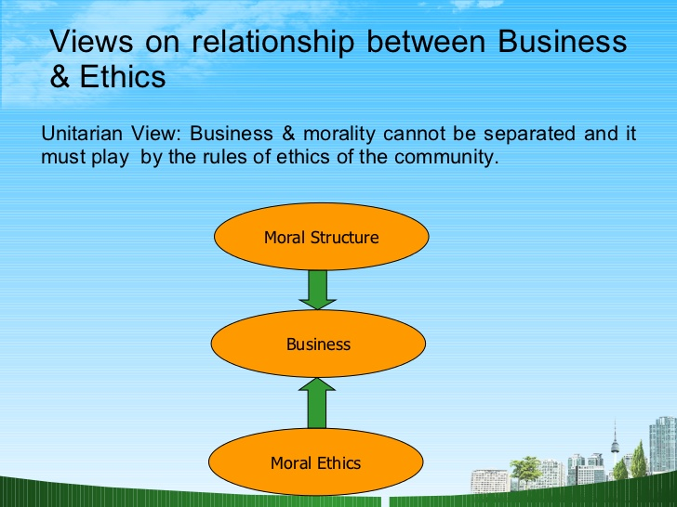

Slide 10
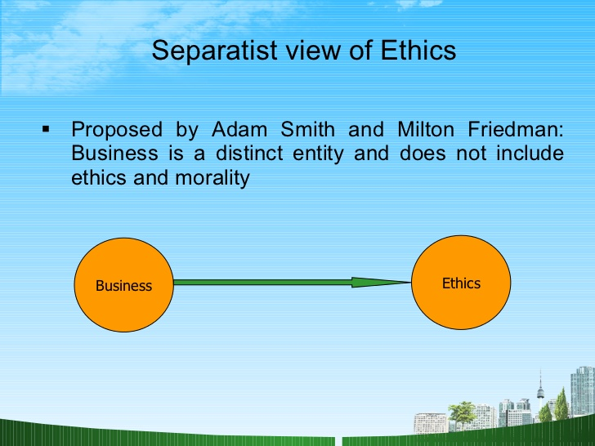
Business of Business is business

Slide 11
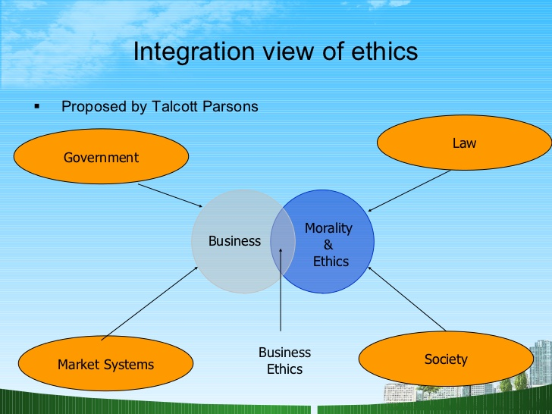

Slide 12
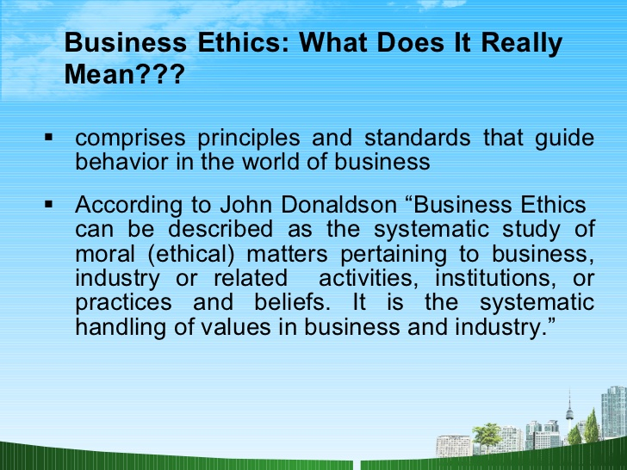

Slide 13
Business Ethics Contd..
Business Ethics is the art and discipline of applying ethical principles to examine and solve complex moral dilemmas.
Business Ethics proves that business has been and can be ethical and still make profits.
Business Ethics is that sets of principles or reasons which should govern the conduct of business whether at the individual or collective level.
Ethical solutions to business problems may have more than one right answer or sometimes no right answer at all.

Slide 14
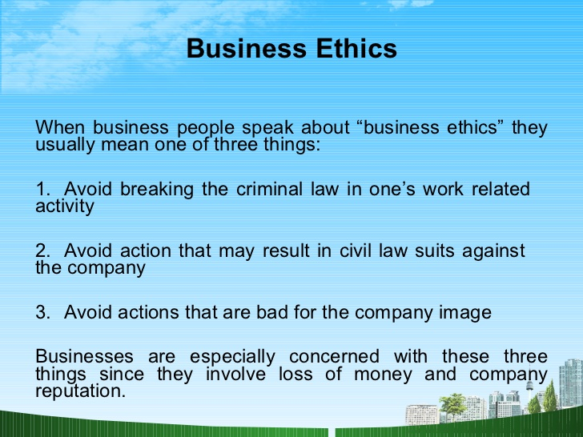

Slide 15
Tata Ethics: What links that forge the Tata Companies together
J.R.D Tata once said this when asked to define the house of Tatas and what links that forge the Tata companies together:
“I would call it a group of individually managed companies united by two factors:
First, a feeling that they are part of larger group which carries the name and prestige of Tatas, and public recognition of honesty and reliability-trustworthiness.
The other reason is more metaphysical. There is innate loyalty, a sharing of certain beliefs. We all feel a certain pride that we are somewhat different from others.”
These several values that JRD Tata refers to have been derived from the ideals of the founder of the group, Jamshedji Tata.

Slide 16
What is not Business Ethics
Ethics is different from religion:
Religion do not address all the problems we confront today: Cyber crimes and environment related issues which are new.
Ethical Standards are different from Cultural Traits
E.g. Caste System : some people are superior to other’s in God creation.
Ethics is different from feelings
Some have bad feelings while doing wrong, criminals may find it good. Most people when do wrong for first time find it bad when getting incentives from that find it OK.

Slide 17
Ethics is not Science
Science is not prescriptive and does not tell us what to do in situations of ethical choices. Moreover , just something is scientifically possible, it may not be ethical to do:
Human Cloning
Ethics is not just collection of values
Ethics is not synonymous with Law

Slide 18
Values
Values can be defined as those things that are important to or valued by Someone: individual or, collectively, an organization.
VALUES PROVIDE THE BASIS FOR JUDGMENTS ABOUT WHAT IS IMPORTANT FOR THE ORGANIZATION TO SUCCEED IN ITS CORE BUSINESS (Vision)
Organizational vision : must be based on and consistent with the organization's core values : integrity, professionalism, caring, teamwork, and stewardship.

Slide 19
Values v/s Ethics
Values are what we, as a profession, judge to be right." Individually or organizationally, values determine what is right and what is wrong, and doing what is right or wrong is what we mean by ethics.
To behave ethically is to behave in a manner consistent with what is right or moral.
Who decides what is Right, what is wrong?
Society

Slide 20
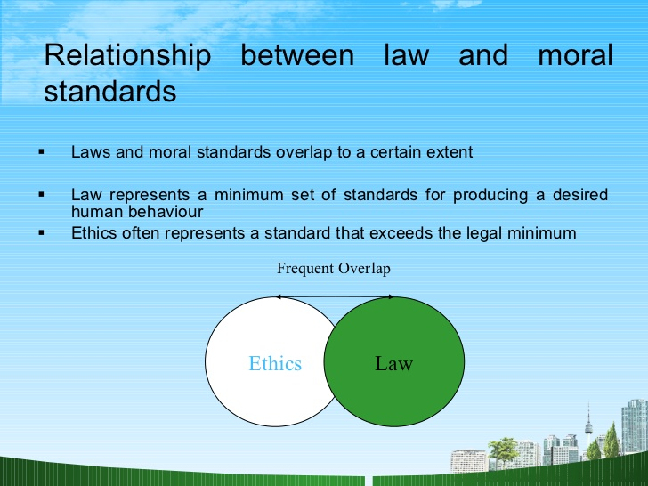

Slide 21
Ethics and law
Law is Reactive.
Law is often slow to develop in new areas of concern.
Legislative and judicial process takes a long time and meanwhile much damage can be done.
Law may deviates from what is ethical
Soldier burried
Eg. Child world versus Toys “R” Us

Slide 22
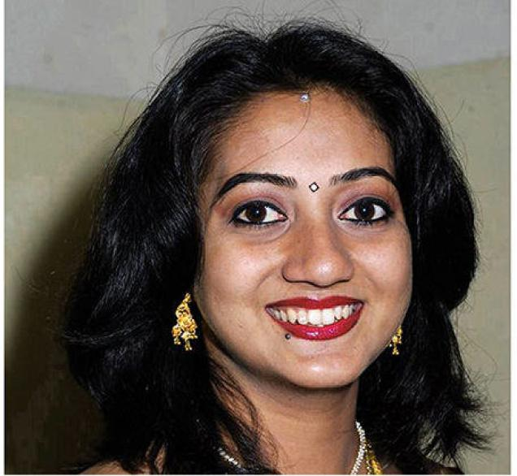
Indian woman dies after being refused abortion
Savita Halappanavar’s death has renewed calls for Irish law to be modified to allow termination if mother’s life is at risk
A woman of Indian origin has died after doctors in Ireland refused to perform an abortion, telling her that “this is a Catholic country”, sparking widespread outrage and renewed calls for immediate reforms to the Irish law to allow termination if the life of the mother is at risk.

Slide 23
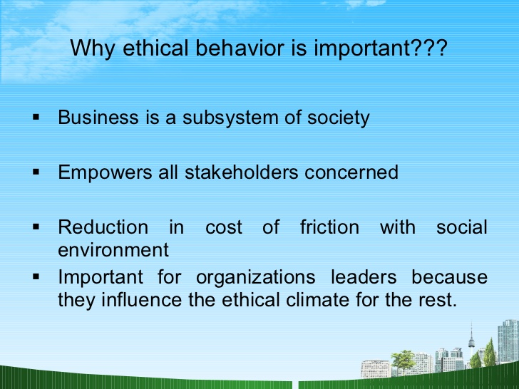

Slide 24
Wells Fargo Banking Scandal
Wells Fargo was the darling of the banking industry, with some of the highest returns on equity in the sector and a soaring stock price. Top management touted the company’s lead in “cross-selling”: the sale of additional products to existing customers. “Eight is great,” as in eight Wells Fargo products for every customer, was CEO John Stumpf’s mantra.
In September 2016, Wells Fargo announced that it was paying $185 million in fines for the creation of over 2 million unauthorized customer accounts. It soon came to light that the pressure on employees to hit sales quotas was immense: hourly tracking, pressure from supervisors to engage in unethical behavior, and a compensation system based heavily on bonuses.

Slide 25
Wells Fargo also confirmed that it had fired over 5,300 employees over the past few years related to shady sales practices. CEO John Stumpf claimed that the scandal was the result of a few bad apples who did not honor the company’s values and that there were no incentives to commit unethical behavior. The board initially stood behind the CEO but soon after received his resignation and “clawed back” millions of dollars in his compensation.
Further reporting found more troubling information. Many employees had quit under the immense pressure to engage in unethical sales practices, and some were even fired for reporting misconduct through the company’s ethics hotline. Senior leadership was aware of these aggressive sales practices as far back as 2004, with incidents as far back as 2002 identified.

Slide 26
The Board of Directors commissioned an independent investigation that identified cultural, structural, and leadership issues as root causes of the improper sales practices. The report cites: the wayward sales culture and performance management system; the decentralized corporate structure that gave too much autonomy to the division’s leaders; and the unwillingness of leadership to evaluate the sales model, given its longtime success for the company.
Questions
What should business leaders take away from this scandal?
What could Wells Fargo have done differently to avert this cultural meltdown?

Slide 27
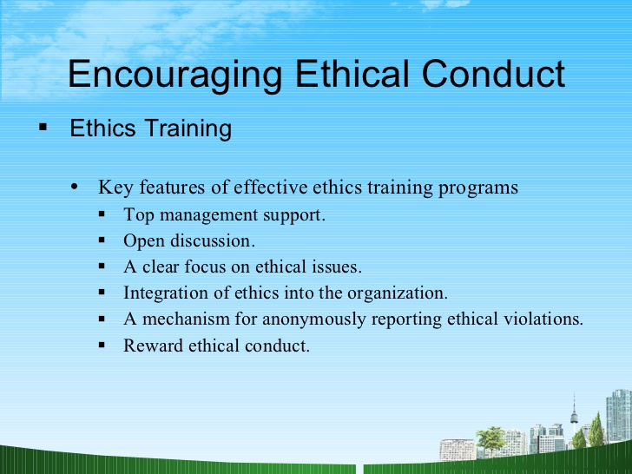

Slide 28
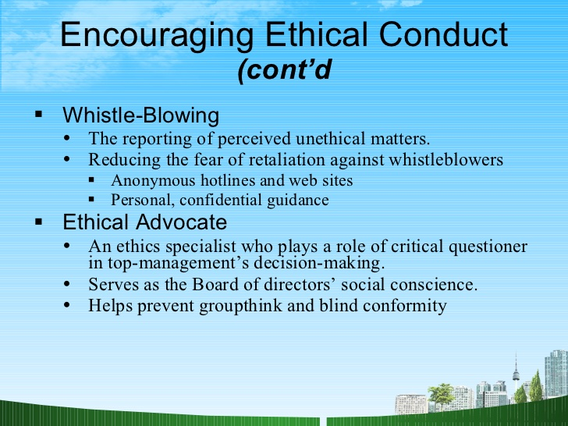

Slide 29
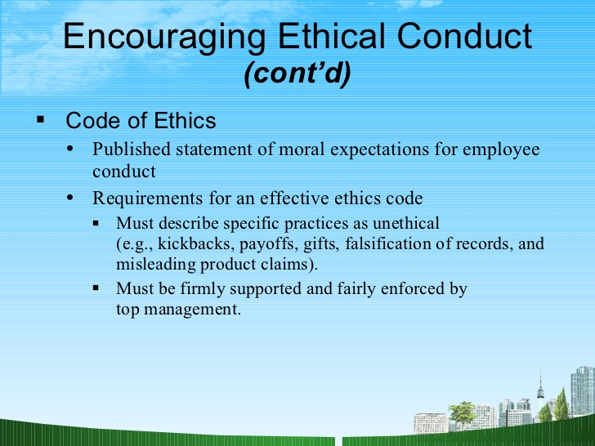

Slide 30
Family Loyalty vs. Meritocracy
Jack O'Reilly, appointed president of the newly-acquired Philippine subsidiary of a large American company, was reviewing the organization with the company's head of human resources.
One thing Jack noted was that the same names reoccurred frequently in several departments.
"It is our tradition," commented the HR head. "Families take care of their own. If one family member gets a good job in a Philippine company, other members of the family apply to join that company and the first member there can help the whole family become successful by helping them get hired and by coaching them to be successful. The company benefits: Our costs of recruiting are lower, we know more about the people we hire, and the commitment to family success results in fewer performance and discipline problems because family members want to please their older relatives.“
Jack O'Reilly wondered how these practices would be regarded in a large American firm, and whether or not he should take action to change them.

Slide 31
Group Activity
Assuming yourself as an entrepreneur, after 2 years of establishment you find lot of unethical practices in your organization like:
Employees taking away stationeries
Problem in accounts
Using office phone for long hour talks
Extended tea and lunch breaks
When you object people find it more intervening and some place their resignations as well.
How would you tackle this issue.

Slide 32
Indian Concept of Ethics
Holistic view of life: Balanced approach to the material and spiritual development of individuals and society.
Spirit of capital or artha is not neglected but driven by Dharma/ethics.
Theory of Purushartha:holistic perspective of balancing the four objects of life: .
Dharma
Artha
kama,
Moksha

Slide 33
Theory of Gunas
Tamasik: selfish
Rajasik: Enlightened Self Interest
Saatvik: Enlightened Collective interest
http://www.au.af.mil/au/awc/awcgate/ndu/strat-ldr-dm/pt4ch15.html

Slide 34

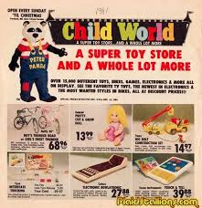
Child world v/s Toys “R” Us
Toys “R” Us employees allegedly bought Child world Inventory off the shelves during a promotion in which customers receives $25 gift certificates for buying merchandise worth $ 100.
The employees of Toys “R” Us accused of selecting products that Child World sells close to cost.: diapers, baby food, infant formula up to $ 1.5 mn.
Toys “R” Us resold items & gifts at huge profit, because their prices were little more than wholesaler price.
The practice is apparently legal, although Child world stated, it excludes dealers, wholesalers and retailers.

Slide 35
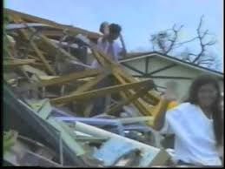
Home Depot: Good ethics or Shrewd Business
Weather forecasters predicted that Hurricane Andrew would strike Miami with full force, customers rushed to stock up on plywood & other building materials.
That weekend 19 Home Depot stores in Southern Florida sold more 4 ft by 8 ft sheets of exterior plywood than they usually sell in 2 weeks.
Aug. 24,1992 hurricane struck, had major devastation.
Prices-for necessities water, food,, building material inflated like anything.

Slide 36
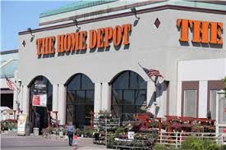
Home Depot initially kept prices at prehurricane level, then because of whole sale price increase (28%). It decided to sell it on cost &take no profit on sales.
It limit quantities so local retailers couldn’t resell it at higher prices.
Home Depot negotiated with suppliers of Ply wood- Georgia Pacific, country’s largest plywood producer to roll back prices to prehurricane level.
Home Depot executives defined it as an act of ethics, not profiting from human misery.
Others say: Shrewd Business Decision.

Slide 37
Presentations
Issues in Corporate Governance :16th Aug.
Meaning of good corporate Governance :16Aug.
Ethical Practices in operations :23rd Aug.
Ethical Practices in Marketing :30th Aug.
Ethical Practices in HR:30th Aug.
Ethical practices in finance +last group:6th Sep.

